Slide 1
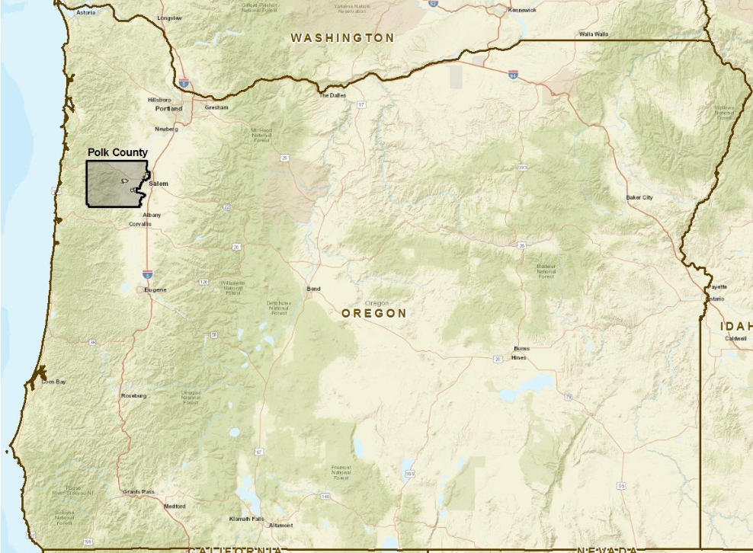
Polk County Broadband
Survey Results

Slide 2
The Survey
Answer basic questions…
1. Who are the internet service providers?
2. What level of service is being provided?
3. What are citizens using the internet for?
4. What is the general cost of service?
5. How do citizens rate their service?
6. Would they like better service?
The process….
Researched and developed survey (IT staff)
Tested the survey twice before mailing (IT Staff)
Sent over 5000 surveys to rural Polk Co property owners (Garten Mail & Print Services)
Compiled the survey responses (Garten Mail & Print Services)
Summarized the results and mapped them (IT Staff)

Slide 3
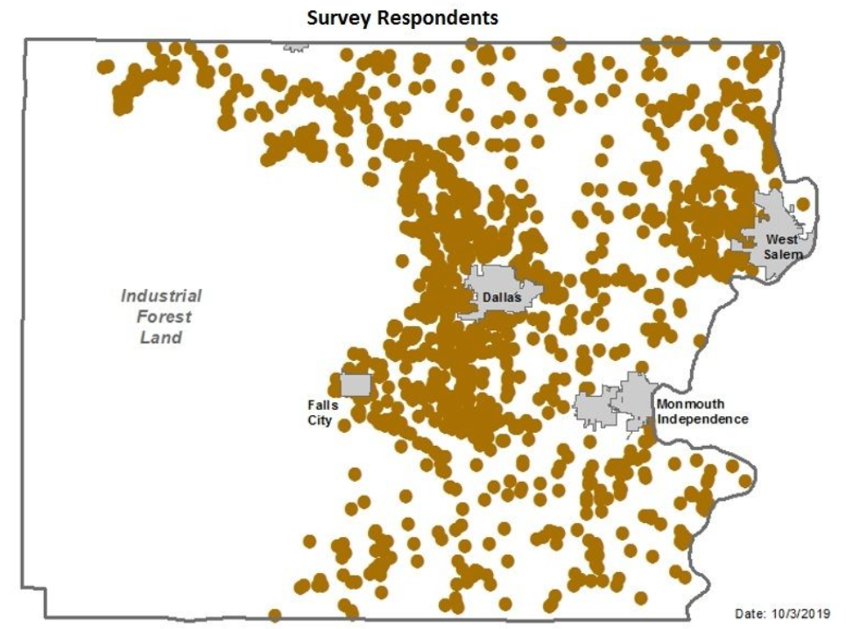
Results
Approximately 32% Response Rate

Slide 4
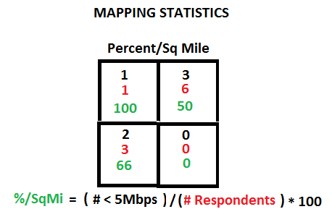
AGGREGATING THE DATA
SIMPLE STATISTICS
% In Each Category = Number Responded / Total Number Responded to the Question
(No Interpolation or Editing)

Slide 5
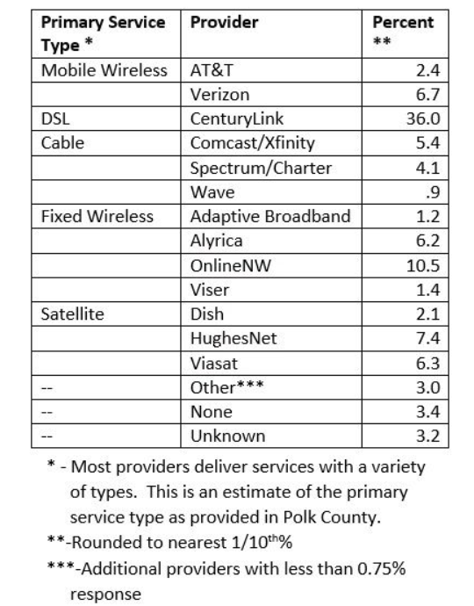
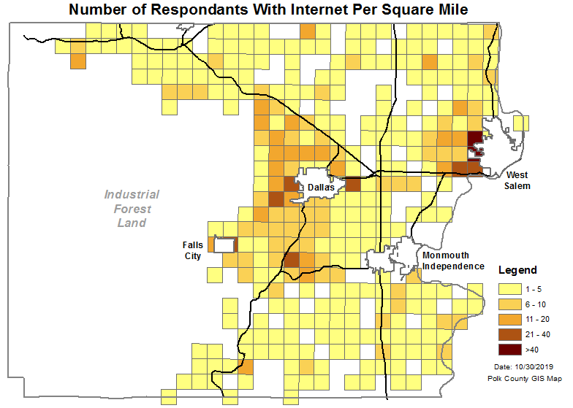
Service Providers
97% answered this question
There are 17 internet service providers in Polk County, who service 94% of respondents that identified a vendor.
Survey respondents are trying to get connected and use a wide variety of providers to do so.

Slide 6
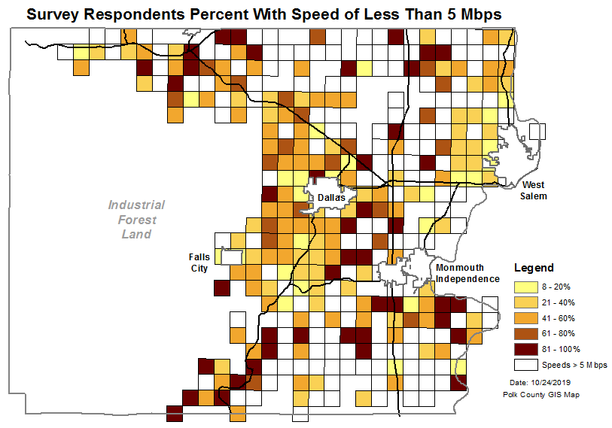
Level Of Service
90% answered this question
Over 25% of respondents have services below “standard” internet access (speeds less then 5Mbps)
Almost 90% have service that is well below the federal definition of broadband service
For Comparison: The average speed of internet service in Oregon is 42.8 Mbps and 90% of Oregonians have access to 100 Mbps or faster service (broadbandnow.com)

Slide 7
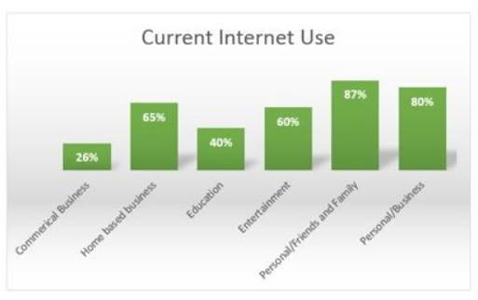
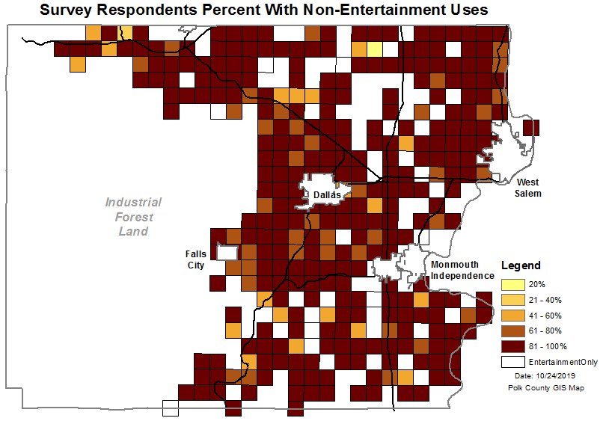
Internet Use
100% answered this question
80% of the respondents use the internet for personal business
40% of the respondents use the internet for education
A significant number of respondents use the internet for commercial or home based business

Slide 8
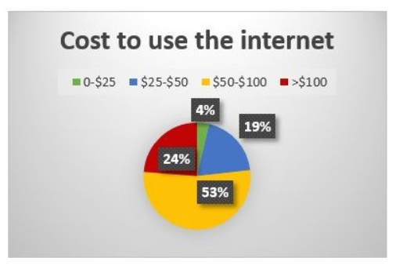
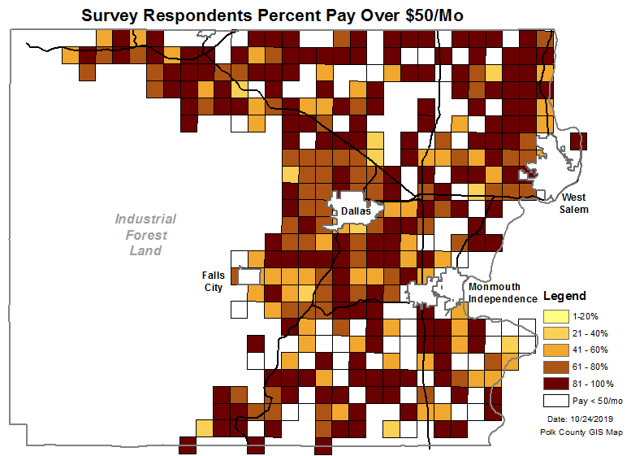
Internet Cost
96% answered this question
Over 20% of the respondents pay over $100/mo for services
Over 75% of the respondents pay over $50/mo for services
For Comparison: The average cost for 60+ Mbps with unlimited access in the US is $60/mo (several references)

Slide 9
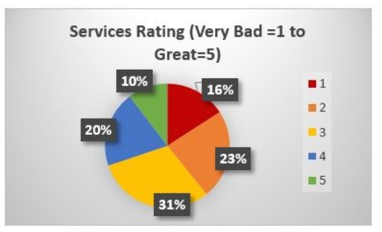
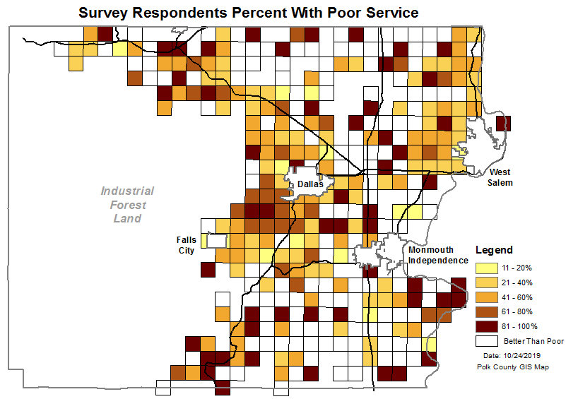
Service Rating
95% answered this question
Almost 40% of the respondents rate their services as being bad
Only 60% rate their service as OK or better (only 30% better then OK)
According to a recent national pole the average ISP received a customer satisfaction rating of 62 out of 100.

Slide 10
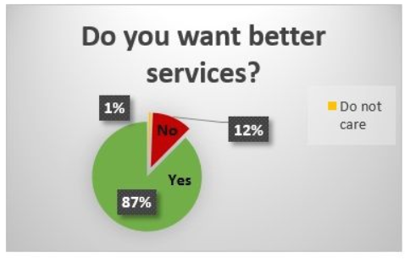
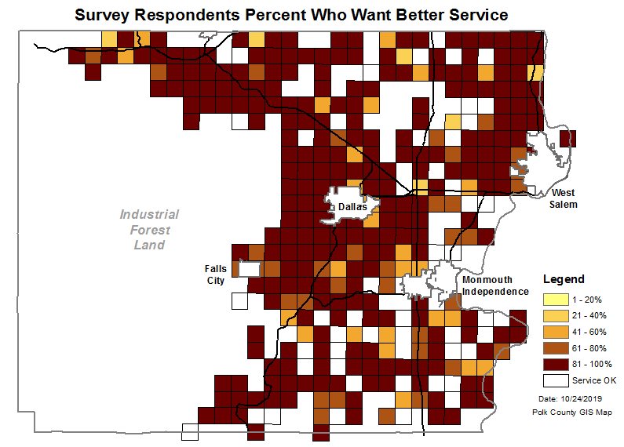
Want Better Service
90% answered this question
Almost 87% want better services.
For those using the internet for more than just entertainment, such as business, 90% want better service.

Slide 11
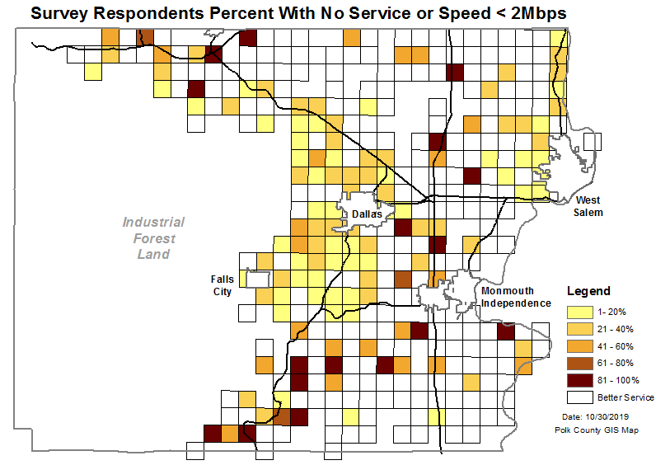
Underserved (Speed & Cost)
90% answered both questions
1 in10 respondents have no or very slow (< 2Mbps) service.

Slide 12
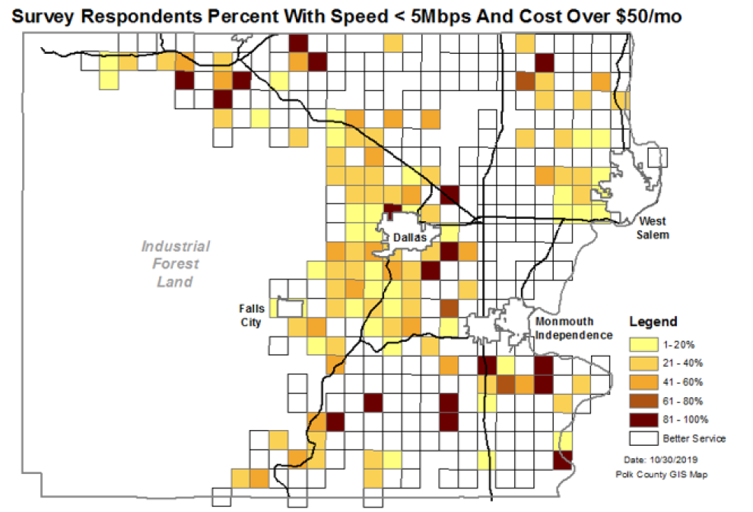
Underserved (Speed & Cost)
90% answered both questions
1 in 5 pay about the same as the national average but receive services that are 10 times slower.

Slide 13
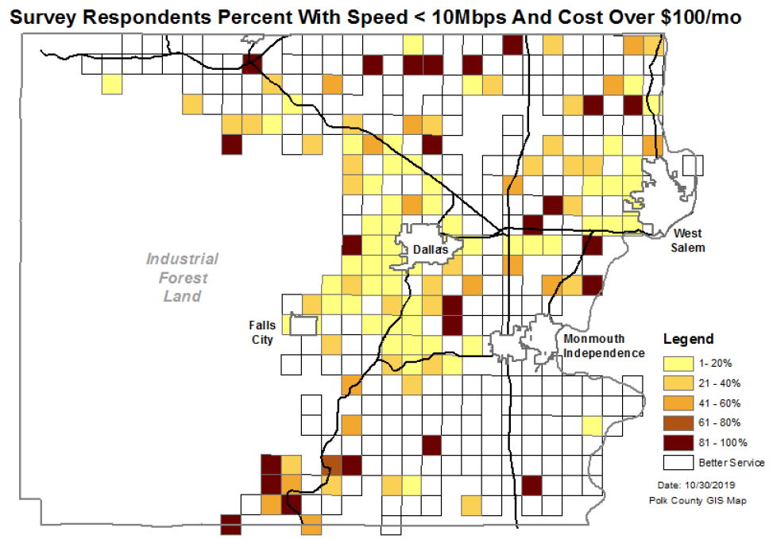
Underserved (Speed & Cost)
90% answered both questions
1 in 10 pay almost twice the national average but receive services that are 5 times slower.

Slide 14
Comments
Approximately 7% of the survey respondents felt strongly enough about the survey to add a comment. Comments fell into four categories.
NO 5G (< 1%) – Significantly against supporting 5G. A sample comment was, “NO 5G!!! This tech. has NOT been adequately safety tested”.
NO Services (<1%) – Felt strongly about not having internet service to comment. A sample comment was, “Not available for internet service by ANY provider in our area”.
NO Government (<1%) – Felt strongly that Polk County should not become an internet provider. A sample comment was “I do not want Polk County getting into the Net, like the $$$ Wreck MINET is!!”
Better Cheaper Service (6%) – Felt strongly that they need cheaper or better service. Two sample comments were: “Latency is a problem with satellite internet, which makes streaming impossible.” and “Should be cheaper! Especially for slow, intermittent.”

Slide 15
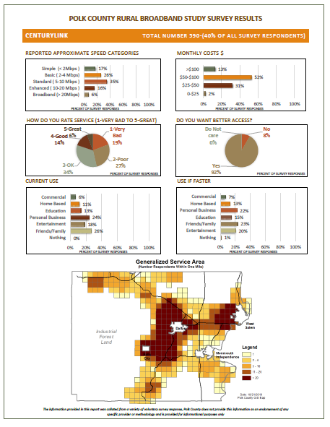
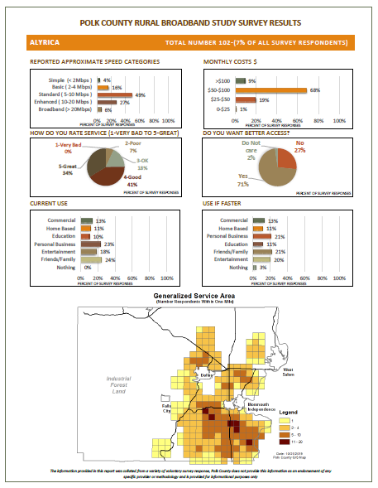
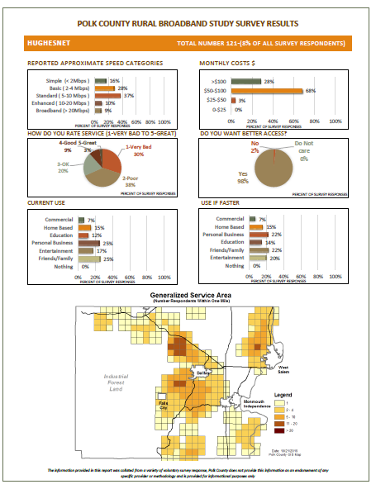
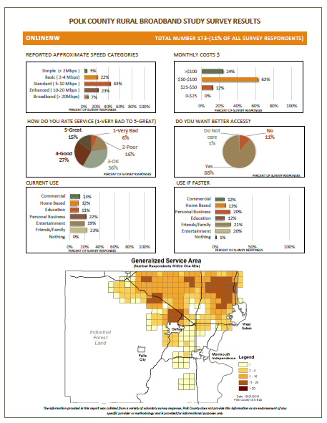
Provider Summaries
For Each Provider
Speeds Offered
Monthly Costs
Service Rating
Want Better Use
Current Use
Use if Faster
Service Territories

Slide 16
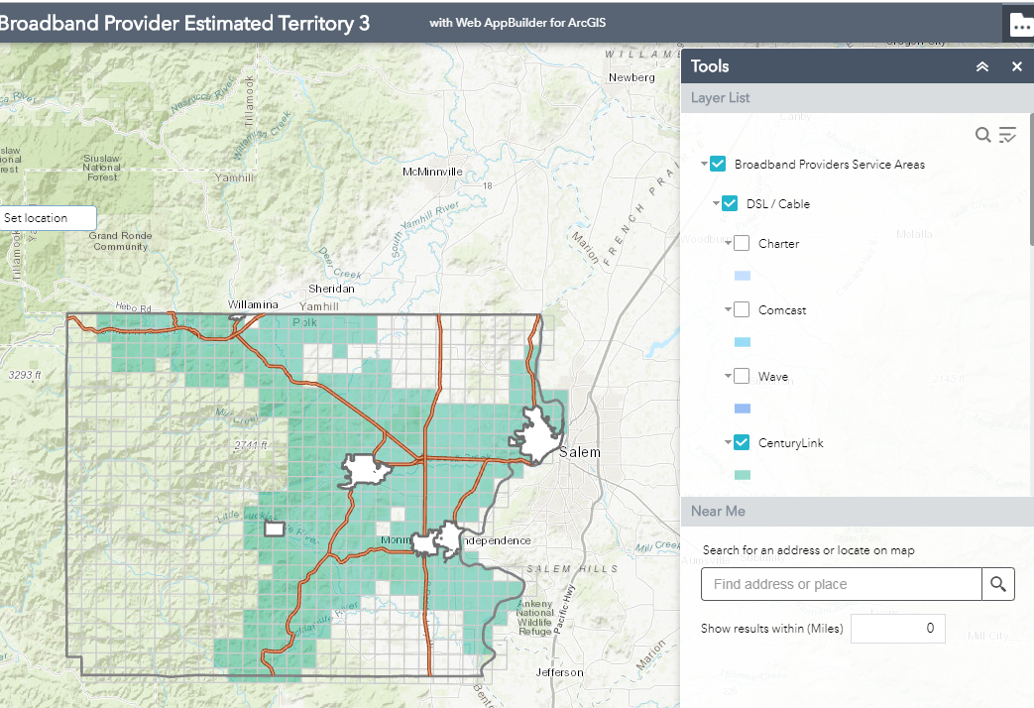
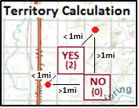
Provider “Service Territories”

Slide 17
Questions? www.co.polk.or.us Main Page (Reports and Interactive Mapping Site)

